Slide 1
Creating & Running a Program
Using Emulator

Slide 2
Programming Steps
Create source program
Editor
.ASM file
Assembler
Assemble source program
.OBJ file
Linker
Link object program
.EXE file

Slide 3

How to Open?
Go To Start Menu → Find emu8086 in Programs
OR
Double click following icon on your desktop:

Slide 4
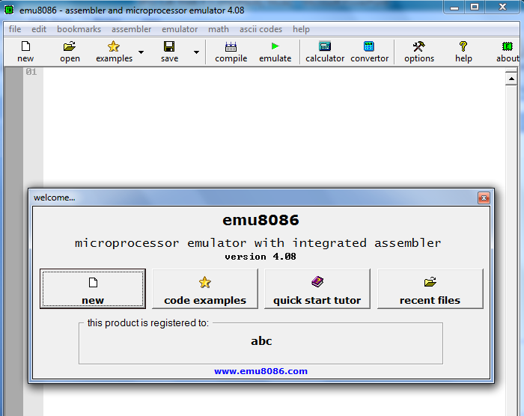
Click Quick Start Tutor & read “Where To Start”

Slide 5
2. Explore menu options like File, Edit, ASCII Codes, Calculator, Converter etc.
1. Cancel this window

Slide 6
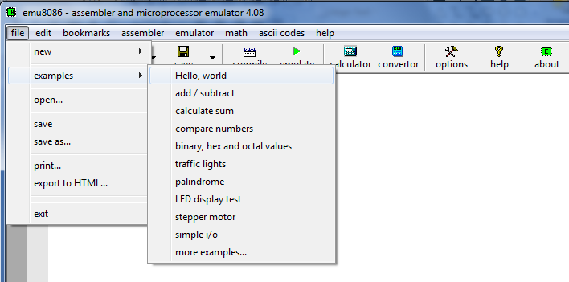
Open a Program from Examples

Slide 7
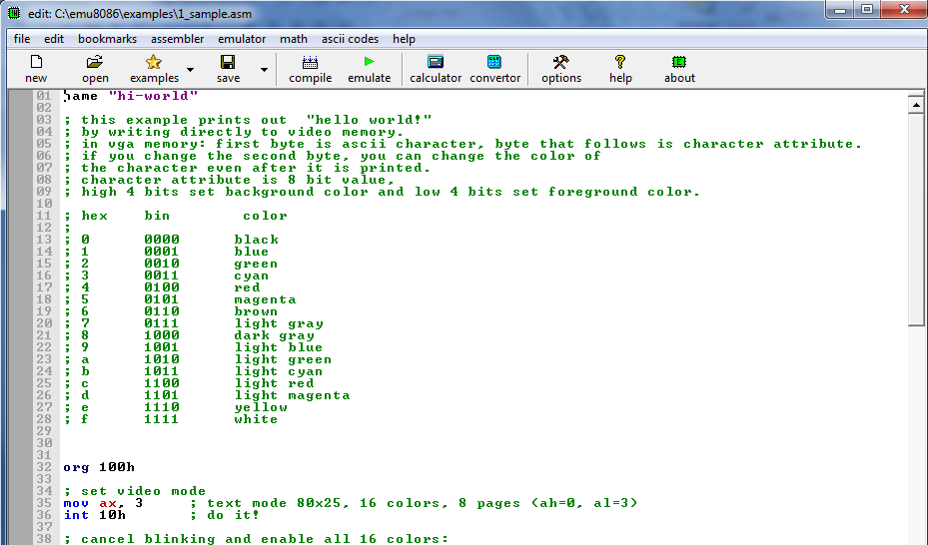
Program loaded in Editor
Imp: An Assembly Language program is saved with .ASM extension

Slide 8
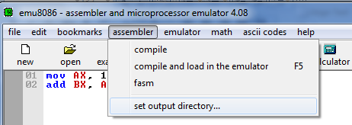
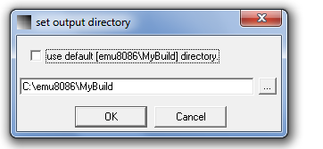
How to change Output Directory
Uncheck this check box
Browse path where executable file will be saved then Click Ok button

Slide 9
How To Run Program
Click Emulate Button

Slide 10
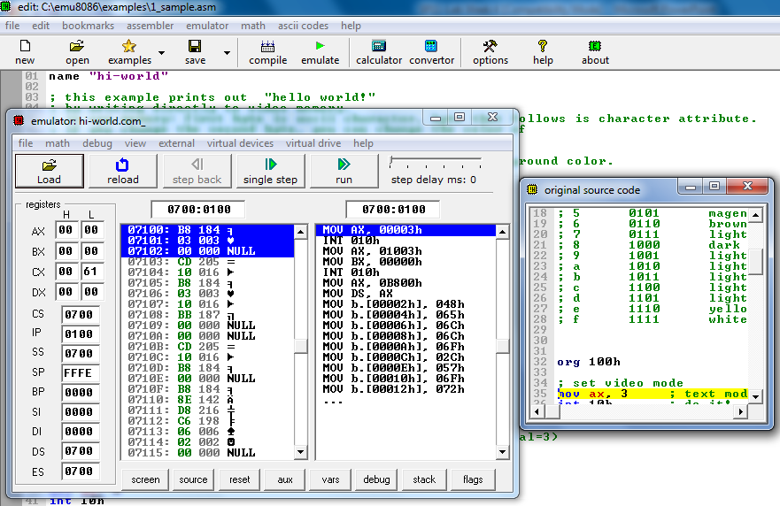

Slide 11
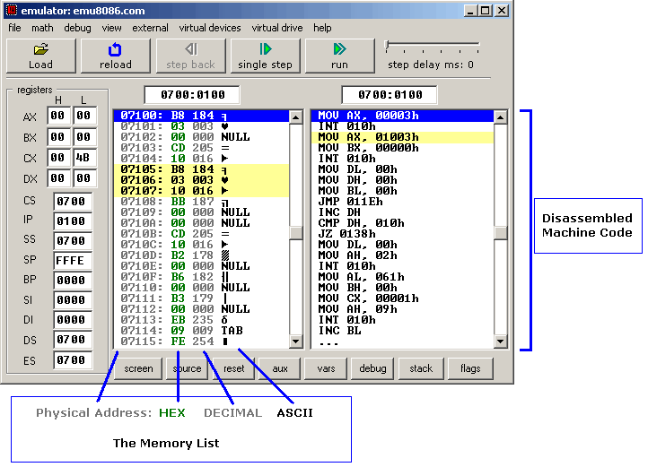
Registers
Logical Address

Slide 12
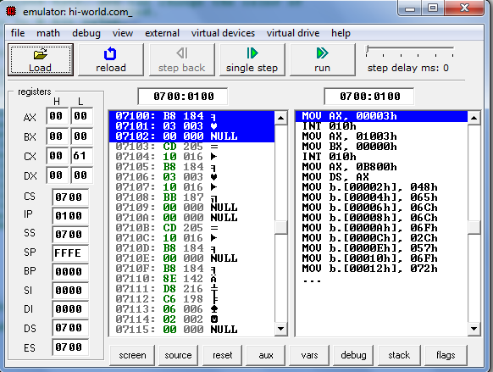
Single Step: To execute instruction one by one i.e. stop after each instruction
Run: To run complete program
Explore what these buttons display!

Slide 13
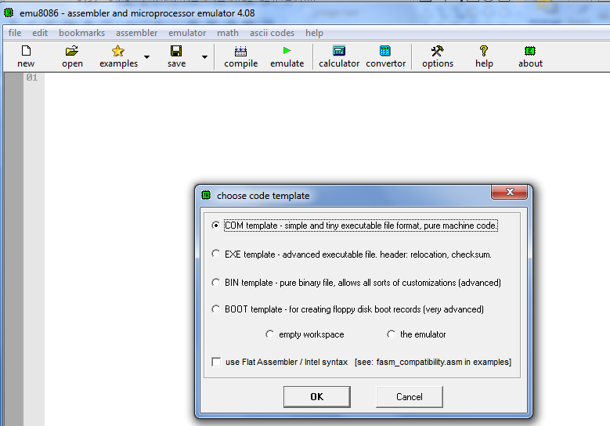
How To Create a New File
Step 1: Go to New
Step 2: Click Cancel Button

Slide 14
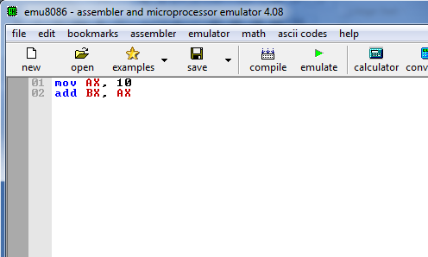
Step 3: Write your code

Slide 15
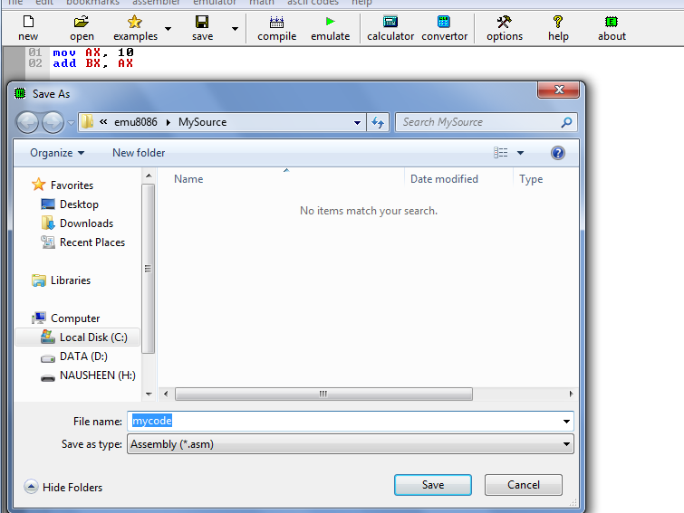
Step 4: Save your code
Write filename then Click Save Button

Slide 16
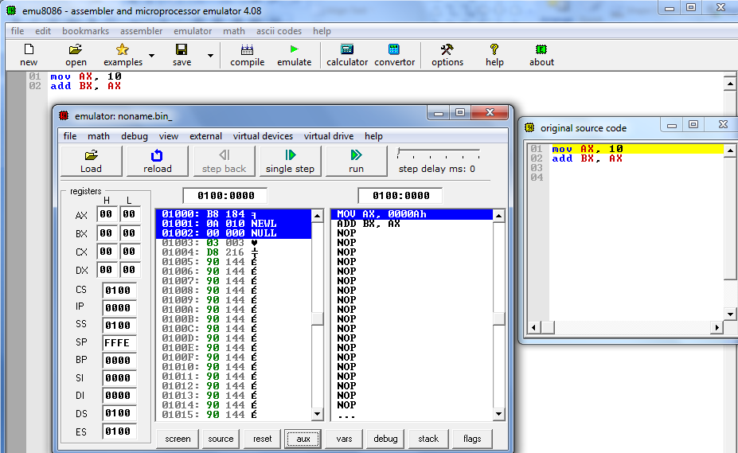
Step 5: Emulate Program
Step 6: Execute instructions step by step & observe changes in register

Slide 17
